Slide 1


Slide 2

خوش آمدید
WELCOME
स्वागत हे
Thank you all for attending this session at #D365UrduHindi Bootcamp 2021

Slide 3

Speaker Intro
Hi Everyone
I’m Nathan Clouse. I’m a Technical Architect with enVista Corporation in USA, headquartered in Carmel, Indiana. I’m a Biz Apps MVP and I’ve been working with AX and Finance and Operations for about 12 years. I focus on all things technical. I specialize in various Microsoft integration technologies that play nice with Finance and Operations and am passionate about application delivery. I post on various topics on my blog at atomicax.com.
Nathan Clouse
Technical Architect
X++
Trainer
ALM
GIT
SQL
MVP
#MVPBuzz
USA
EMAIL
nclouse@envistacorp.com
Twitter
@NathanClouseAX
D365FO, Git and ALM: how to deliver more, faster

Slide 4
What is Source Control?
Azure DevOps Basics
Starting with Git
Automation and Actions
What is Git and why you should consider using it
Azure DevOps is more than just source control
Quick overview of converting to Git from TFVC
What automation and actions are available for events using Azure DevOps

Slide 5
YAML
ATL
SysTest
Q & A
What is YAML and how can we use it?
Discuss the ATL Framework
Discuss the SysTest Framework
Open Question and Answers

Slide 6
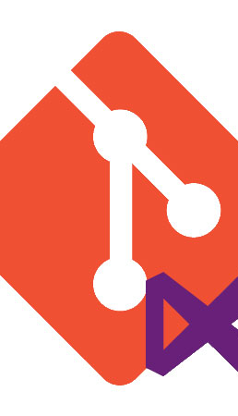
What is Source Control?
Tracks and Manages code
For F&O…
TFVC – Team Foundation Version Control
Git
GitHub
Azure DevOps
GitLab

Slide 7
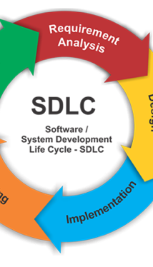
Beyond the Software Development Life Cycle (SDLC)
Not just software development
Not just software delivery
Application delivery and solution management

Slide 8
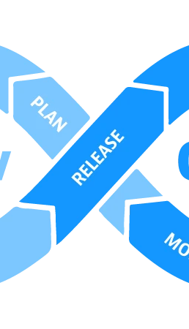
What is DevOps?
What Source Control Should Really do
Manage
Plan
Create
Verify
Package
Secure
Release
Configure
Monitor
Protect

Slide 9

TVFC Is not ideal
But it’s supported
Push based
Branches last nearly forever
Monolithic

Slide 10

Git is great
Not Supported
Modern
Pull based
Branches are short lived

Slide 11
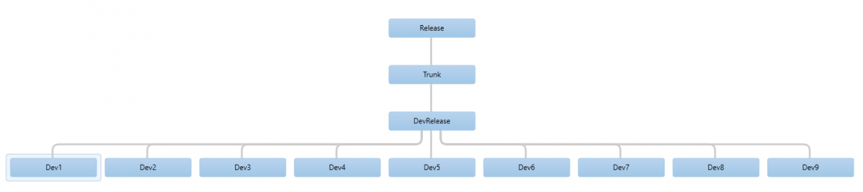
AX 2012 TVFC Example

Slide 12
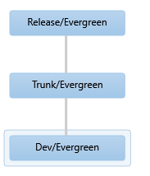
D365 F&O TFVC Example

Slide 13
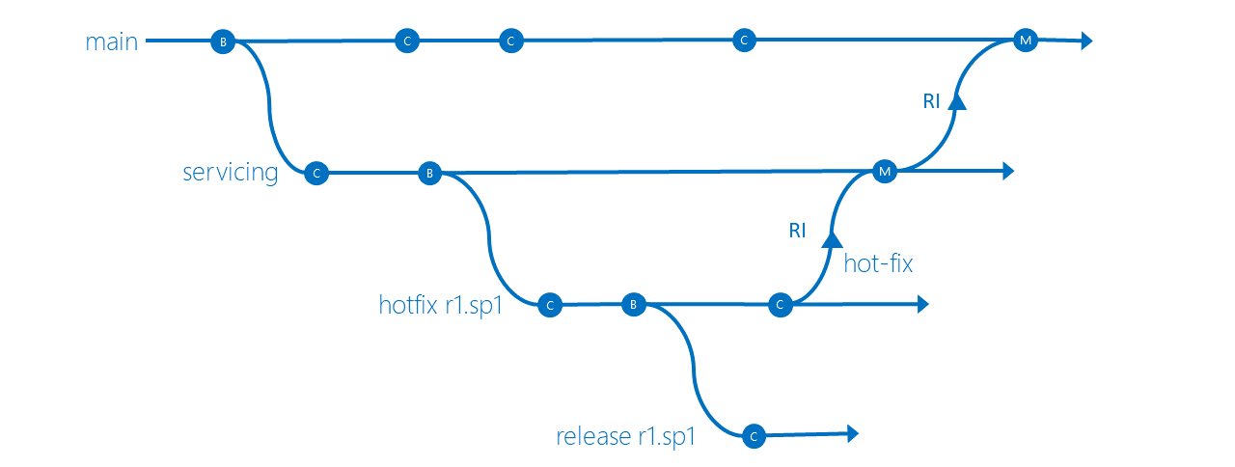
TFVC Conceptual

Slide 14
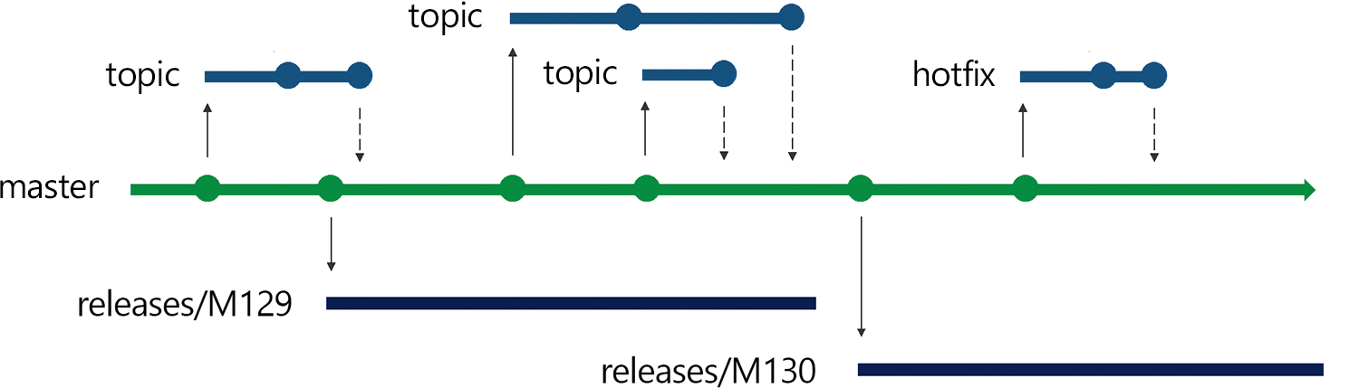
Git Conceptual

Slide 15

TFVC Isn’t all bad
Shelvesets
Gated Check-ins
http://www.atomicax.com/article/getting-started-gated-checkins
Policies
http://www.atomicax.com/article/getting-started-tfvc-and-d365fo

Slide 16

Git also has good things
Projects
Need to relocate
Per Package
Instance Directory
Work Offline
Branching
Per work item
Or per requirement
Reviews
Pull Requests

Slide 17
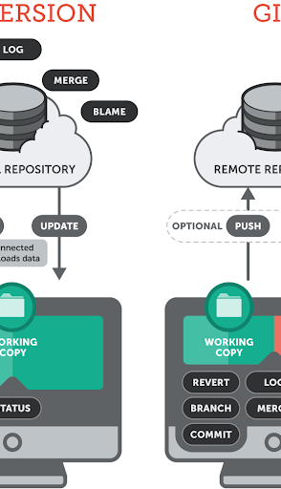
Why is git better
Modern
Matches how things work in the real world
More “agile”
Meet requirements, 1 at a time
More Tools, More automation, More Actions

Slide 18
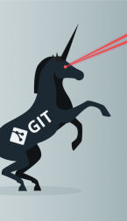
Converting to git
New Git Repo
New Branch
Move in code
Add .gitignore file
Relocate VS Projects
Clean-up; PR (Pull Request), delete old branch, lock TFVC
More Info: http://www.atomicax.com/article/moving-tfvc-git-azdo
Notes:
http://www.atomicax.com/article/moving-tfvc-git-azdo

Slide 19

Converting your brain to git
Change in how you think
Branch per work item
Branch per requirement
How you work
We’re pulling together, not pushing alone

Slide 20
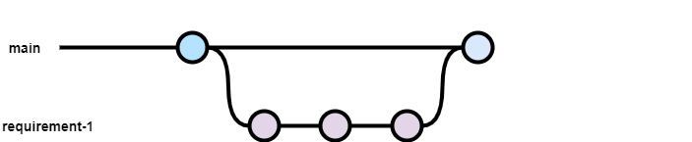
When to Commit

Slide 21

Example of branch strategy
Notes:
Source: https://nvie.com/posts/a-successful-git-branching-model/

Slide 22

What is a pull request
Pull requests let you tell others about changes you've pushed to a branch in a repository. Once a pull request is opened, you can discuss and review the potential changes with collaborators and add follow-up commits before your changes are merged into the base branch.

Slide 23
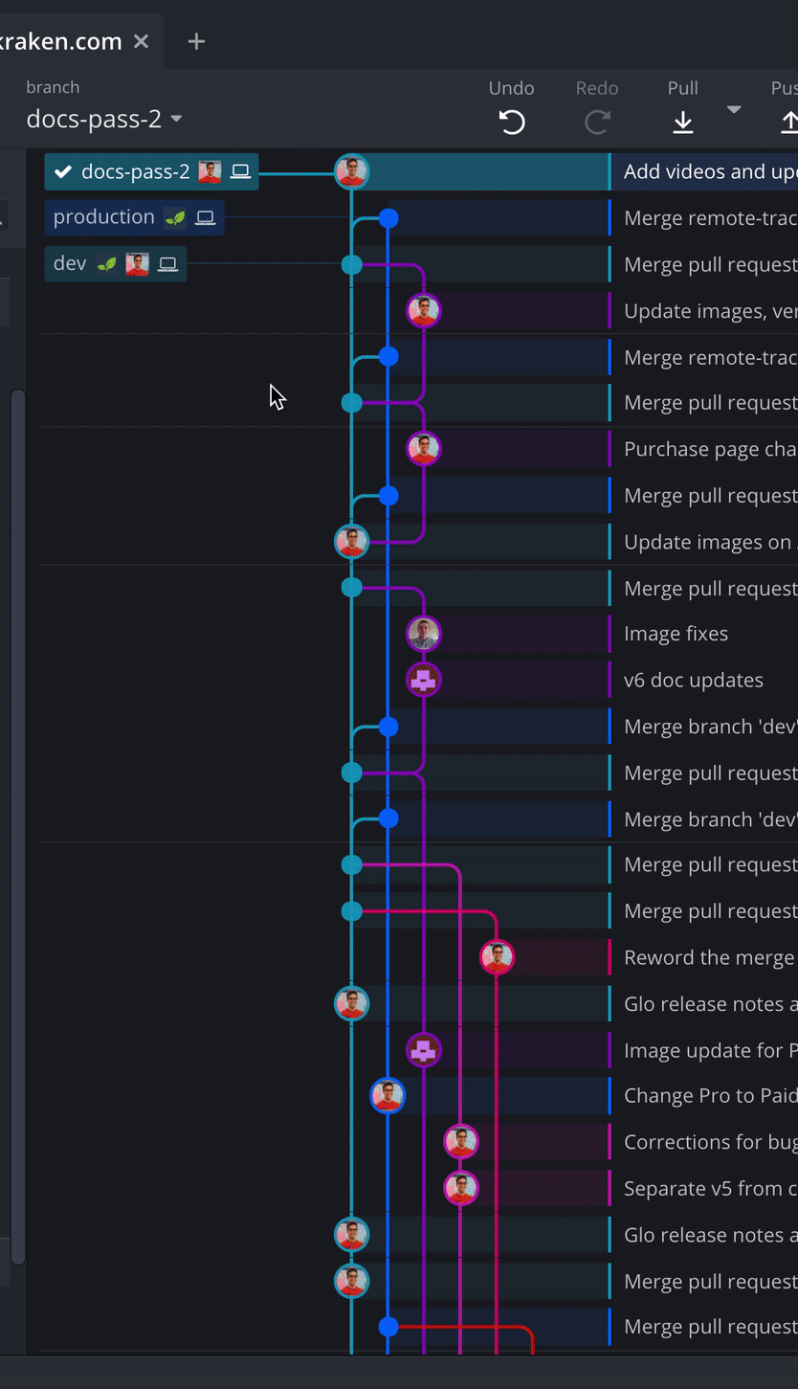
When to Create a pull request
When development is done
Test cases created
Tested

Slide 24
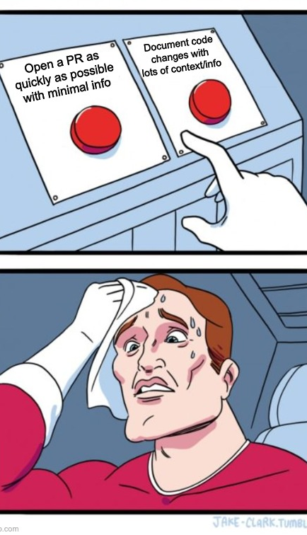
How to create a pull request
In Visual Studio
In Azure DevOps
GitHub
GitLab
etc.

Slide 25
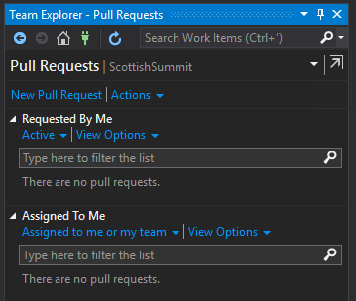
In Visual Studio

Slide 26
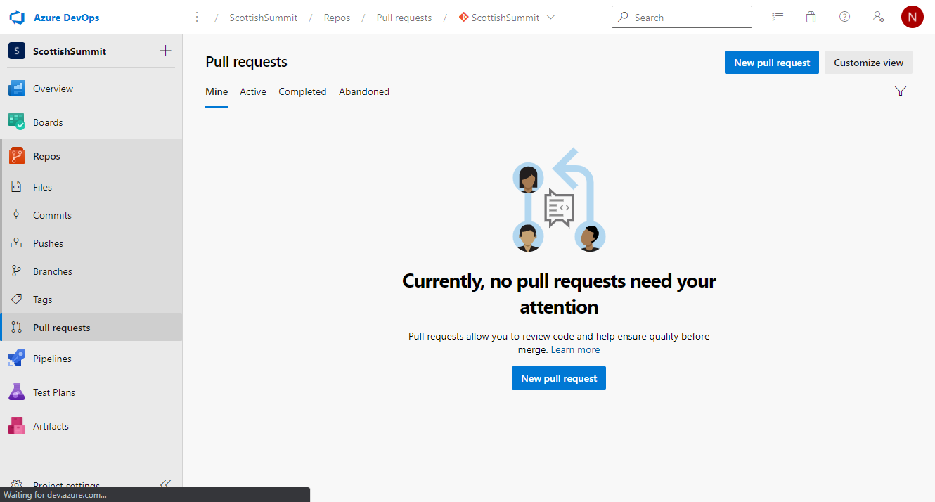
In Azure DevOps

Slide 27

Automation and actions
Build a pull request before review
Checks for Pull Requests
Automated testing for Pull Requests (Advanced)
Automated Build for Commits (Advanced)

Slide 28
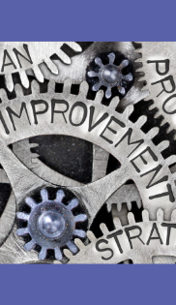
What is a quality bar?
Minimum acceptable state for a set of changes
Compiles
Compiles and passes Unit Tests (SysTest)
Compiles and passes Unit Tests (SysTest), ATL tests

Slide 29
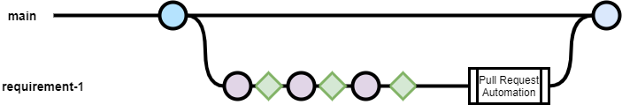
Extended Branch and pull request timeline
Notes:
Pink circle is commit, green diamond is an automated build with email feedback

Slide 30
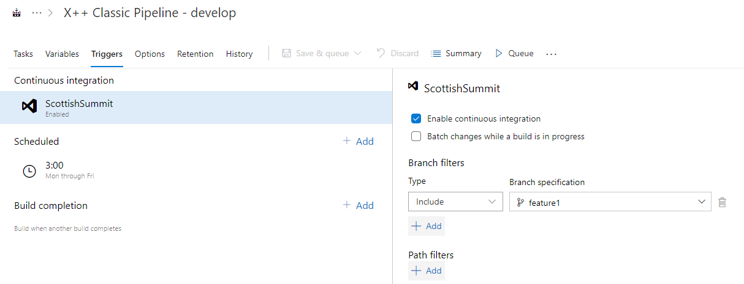
Continuous integration

Slide 31
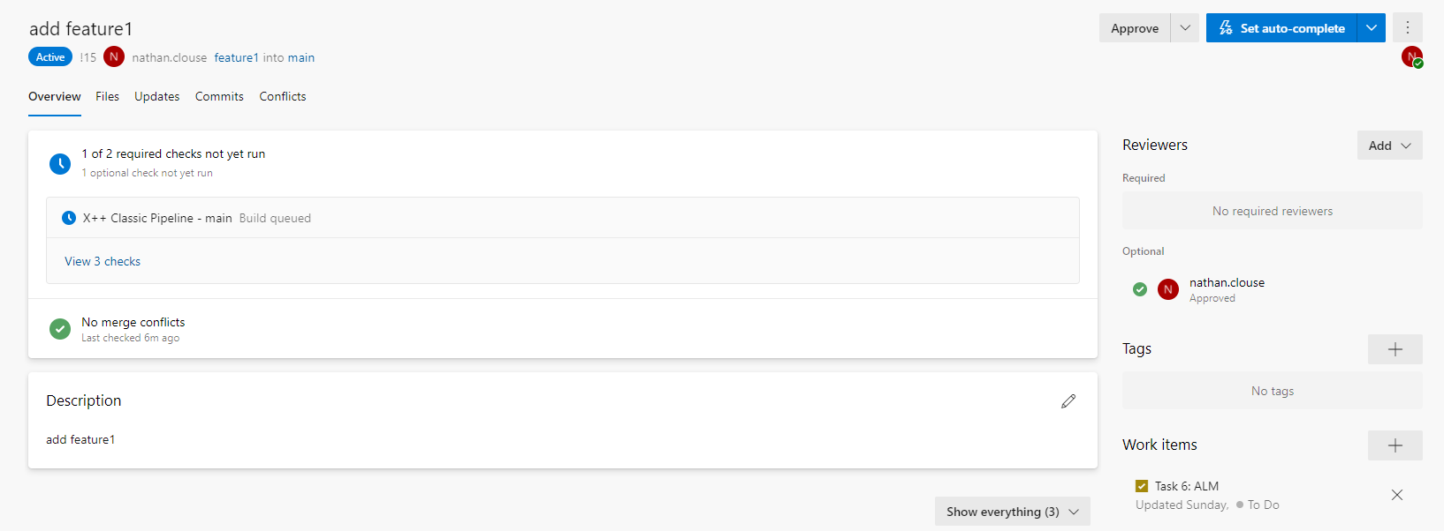
Pull Request Example

Slide 32
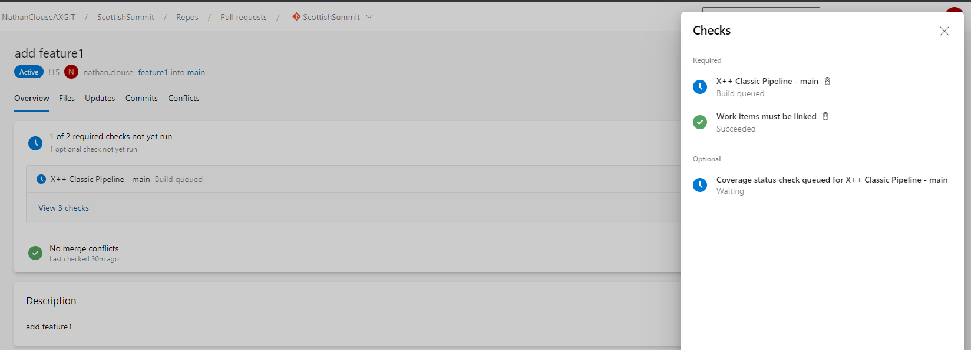
Pull Request Checks

Slide 33
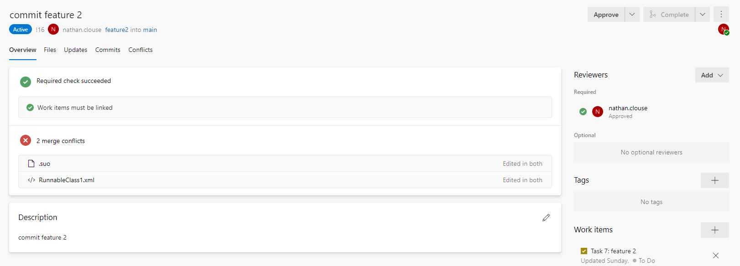
Example Pull Request with Merge Conflicts

Slide 34
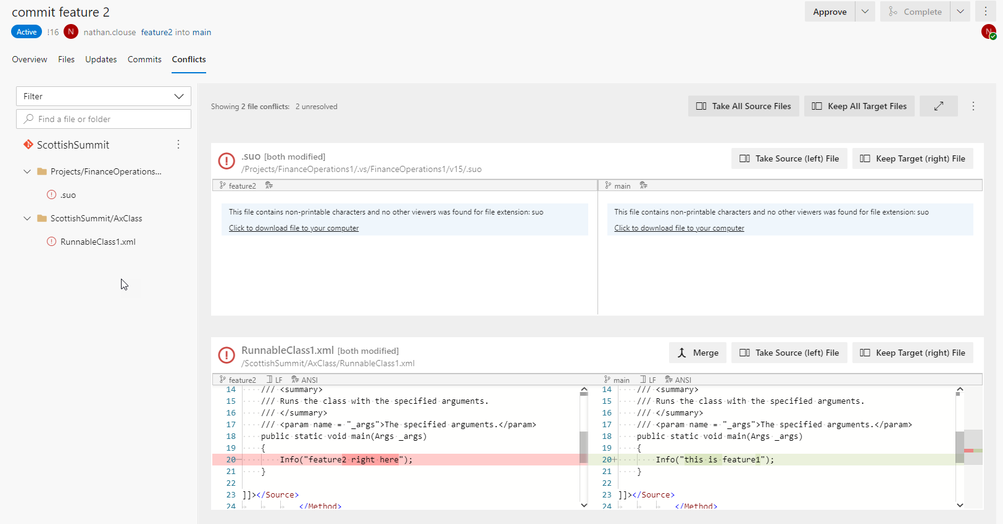
Merge Conflicts

Slide 35
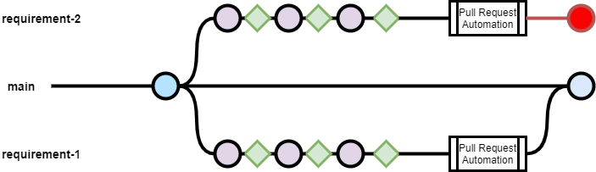
Combined Branch and pull request example

Slide 36
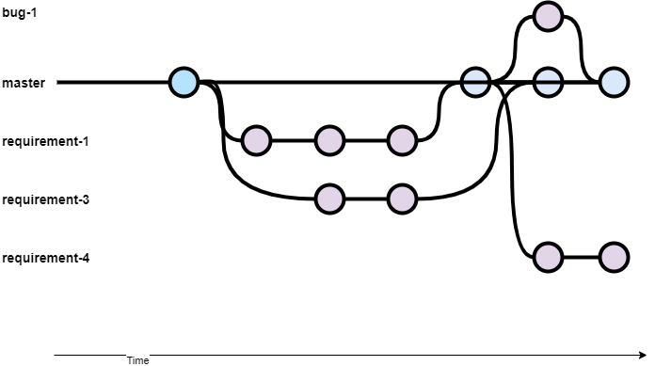
Branch and Resource Management
Notes:
Blue is 1 dev, green is another dev

Slide 37
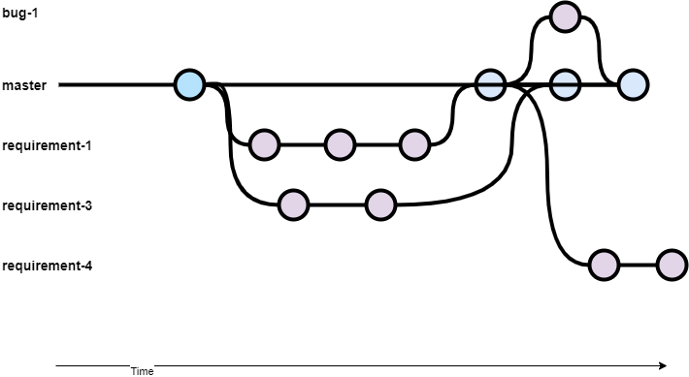
Branch and Commit Management
Notes:
1 dev working on multiple work items

Slide 38

YAML – pipelines as code
YAML is a human readable data serialization language
Can be added to source control
Can be used to create pipeline from source control on demand

Slide 39
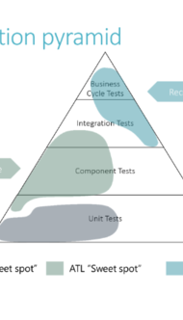
Build and test
SysTest
Automatic discovery
Built into build template*
Used for unit tests
ATL (Acceptance Test Library)
Consistent, Discoverable, Performance
Used for component or simple integration tests

Slide 40
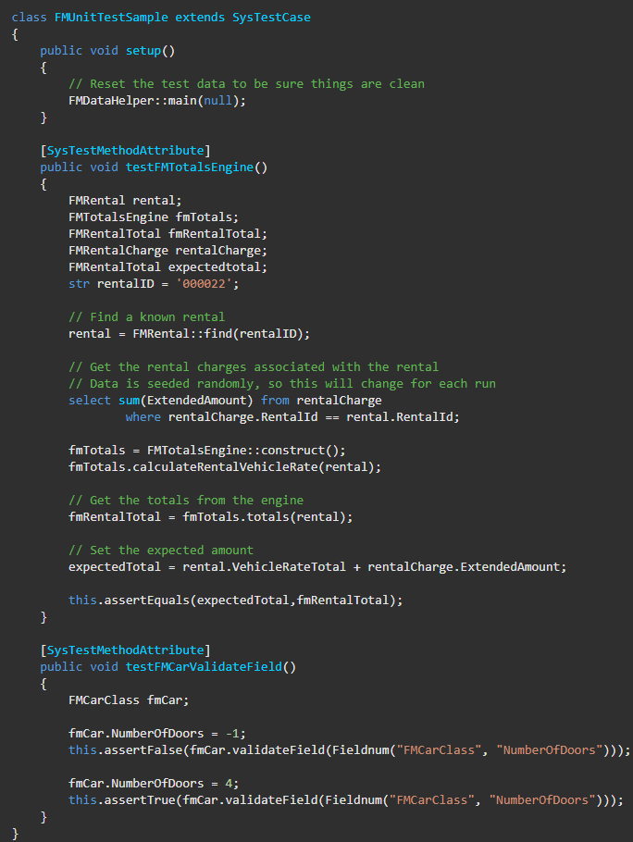
SysTest

Slide 41


Slide 44
SysTest

Slide 45
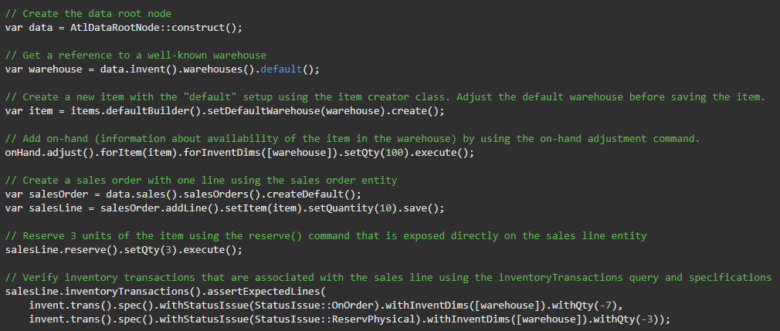
ATL

Slide 48
ATL

Slide 49

Build and test - Pipelines
Using Serverless Builds
Simple Build
Azure Hosted
Using Dedicated Build Server
Simple Build
Database Sync
Unit Tests
ATL Tests
Doesn’t have to be Azure Hosted

Slide 50

BUILD and test - infrastructure
Azure Hosted
Orchestrated through AZDO Pipelines
Cloud Hosted
Provisioned by LCS
Hosted in Azure
On Premise / Other
Modify VHD from MSFT to function as a build machine
Hosted where you would like
Could be in Azure or On prem

Slide 51
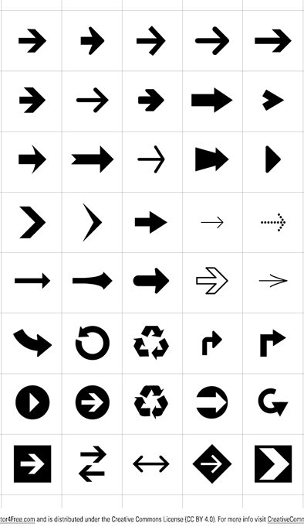
For more detailed info, please go to:
https://ariste.info/en/msdyn365-azure-devops-alm/

Slide 52
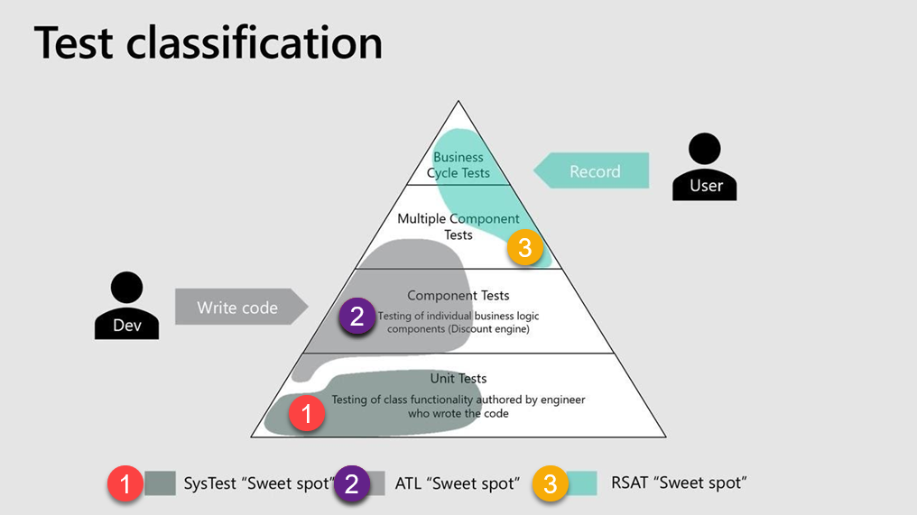

Slide 53
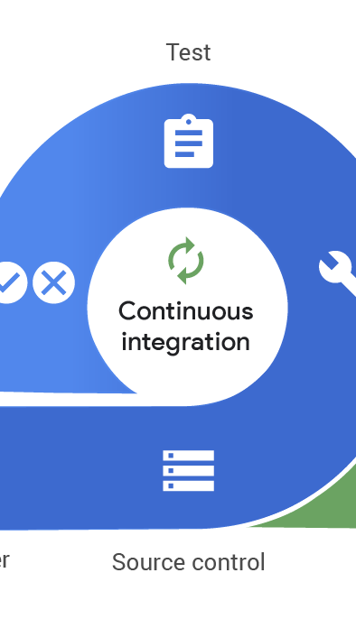
Automated Release
Release to LCS
Release to UAT
Cannot Release to PROD using automation

Slide 54
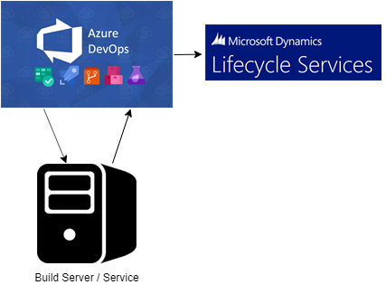
Release to LCS
Stores result in LCS for your build in your asset library
Easy to select from
No additional fuss
Period manual cleanup in LCS

Slide 55
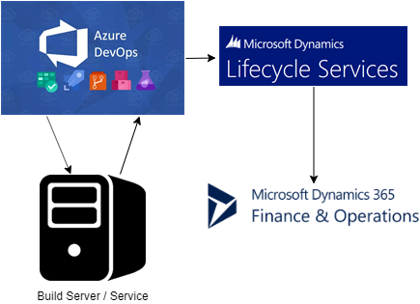
Automatic deployment to a standard environment like UAT
PROD / Operations not supported

Slide 56
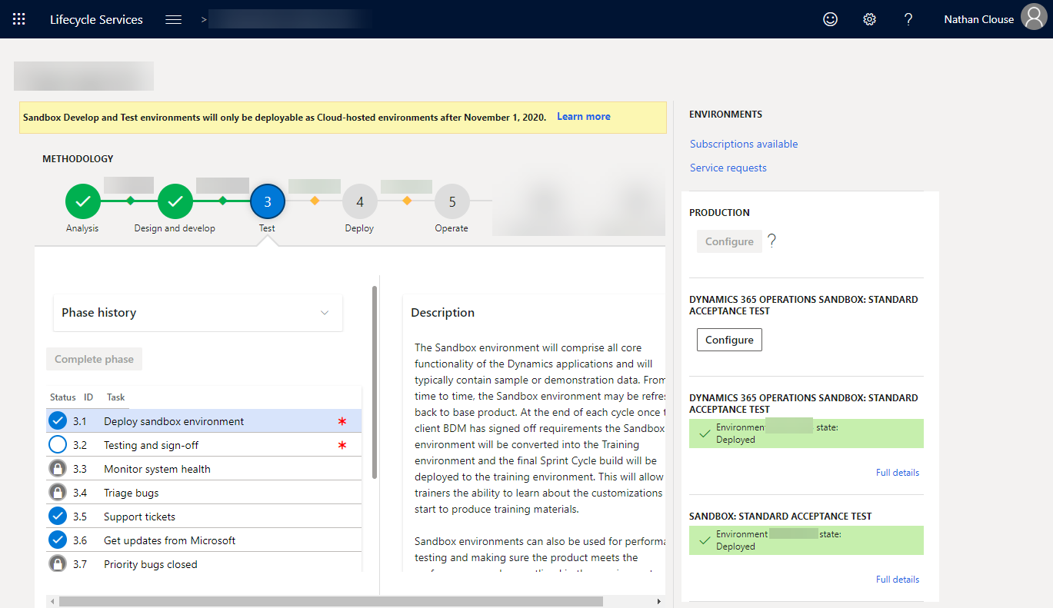

Slide 57

F&O Pipelines
For more detailed info on how to configure this, please see:
https://ariste.info/en/2019/02/setting-up-release-pipeline-in-azure-devops-for-dynamics-365-for-finance-and-operations/

Slide 58
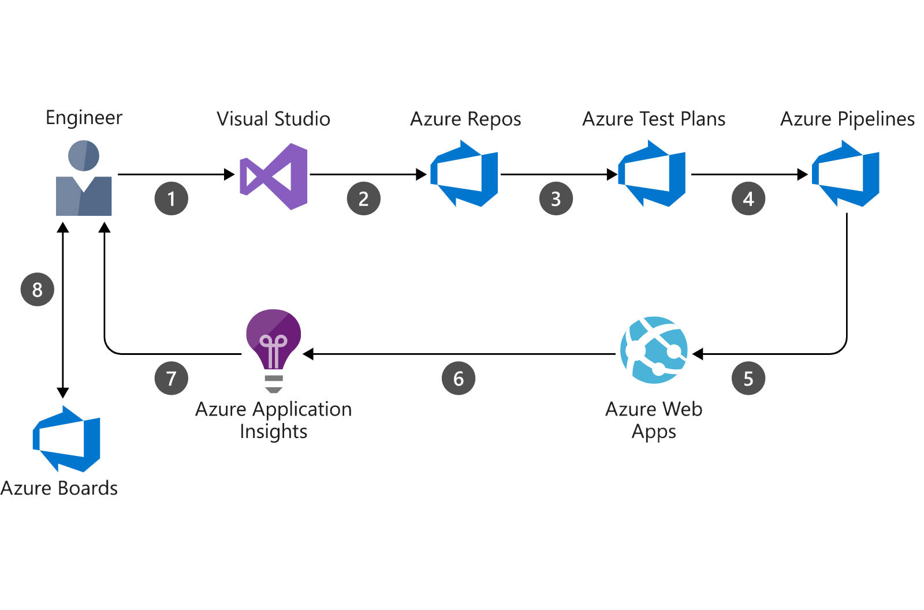
New Feedback Loop
LCS
LCS

Slide 59
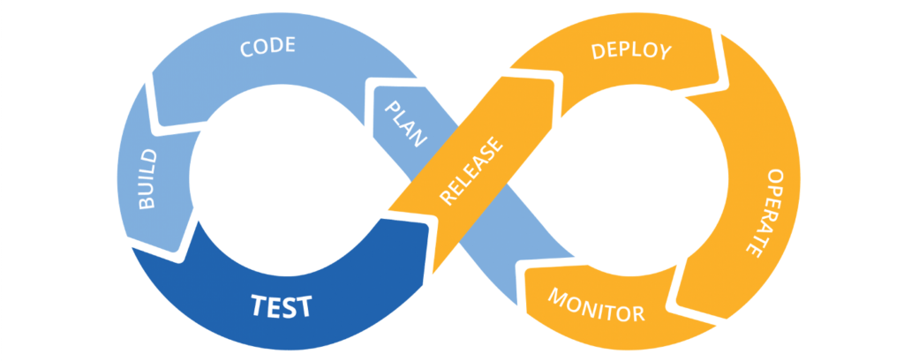
New Feedback Loop

Slide 60

Sources
http://www.atomicax.com/article/giting-started-git-d365fo-and-other-puns
http://www.atomicax.com/article/getting-started-gated-checkins
http://www.atomicax.com/article/moving-tfvc-git-azdo
http://www.atomicax.com/article/getting-started-tfvc-and-d365fo
http://www.atomicax.com/article/why-gated-check-ins-are-awesome
http://www.atomicax.com/article/staging-and-git
https://ariste.info/en/msdyn365-azure-devops-alm/

Slide 61

Sources
https://msdyn365fo.wordpress.com/2020/02/06/msdyn365fo-build-with-yaml-file-the-future-is-now/
https://docs.microsoft.com/en-us/azure/devops/pipelines/yaml-schema?view=azure-devops&tabs=schema%2Cparameter-schema
https://github.com/microsoft/Dynamics365-Xpp-Samples-Tools/tree/master/CI-CD/Pipeline-Samples
https://msdyn365fo.wordpress.com/2021/04/

Slide 62
Sources
https://docs.microsoft.com/en-us/dynamics365/fin-ops-core/dev-itpro/perf-test/testing-validation
https://docs.microsoft.com/en-us/dynamics365/fin-ops-core/dev-itpro/perf-test/acceptance-test-library?WT.mc_id=BA-MVP-5003744

Slide 63
In summary
GIT can help take your delivery to the next level with automation in:
Build
Test
Deployment

Slide 64
THANK YOU
FOR COMING HERE TODAY, ANY QUESTIONS?
Keep an eye on other Bootcamp sessions.
Slide deck can be downloaded from https://github.com/NathanClouseAX/CommunityPresentations/tree/master/2021

